Slide 1

Covid-19 Impact
correlation between COVID Cases and Distribution of Pitzer Vaccine.
correlation between COVID Cases and Unemployment Rates.
correlation between COVID Cases and Restrictions.
correlation between COVID Cases and Flu Pneumonia
Map the outcome

Slide 2
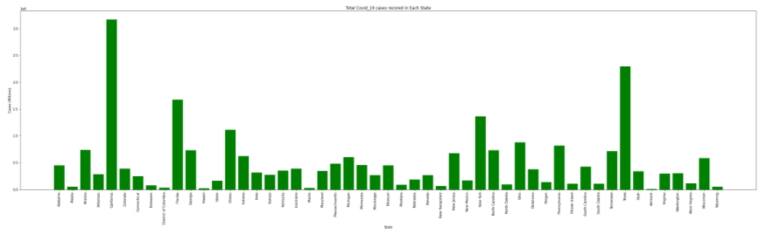
Confirmed Covid-19 per Each State

Slide 3
High Confirmed Covid-19 Cases were in California with 3,169,935 cases. It is higher than the runner up by 875,862 cases which is Texas
Lowest Confirmed Covid-19 Cases were in Vermont with 11,379 cases. It is lower than the runner up by 14,063 cases which is Hawaii

Slide 4
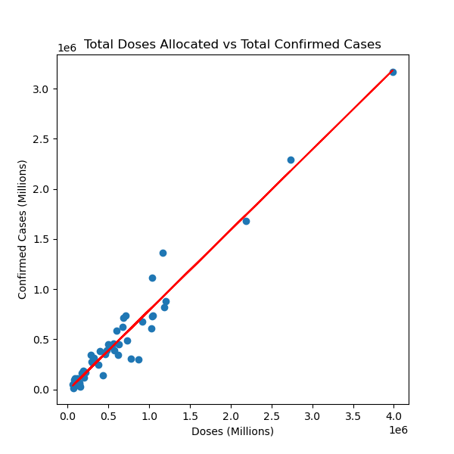
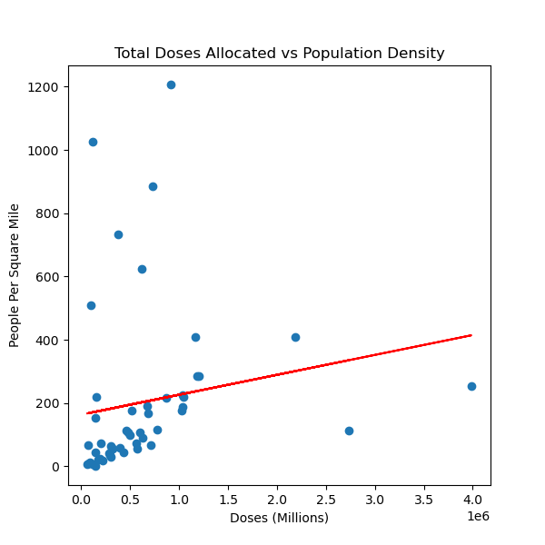
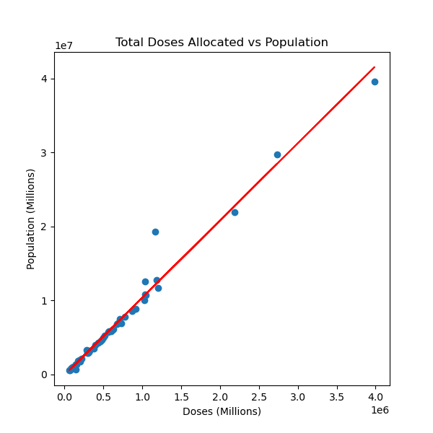
Relationships of Allocated Dosage Distribution to Confirmed Cases, Population Density, and Population
There is virtually no correlation between Population Density to dosage allocation with a factor of .17
There was very strong correlation between the vaccine distribution as it was related to either Total Confirmed Cased and Total Population. Total population as expected was a near perfect correlation factor of .99

Slide 5
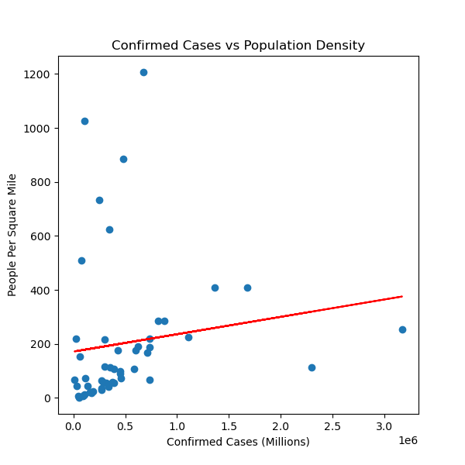
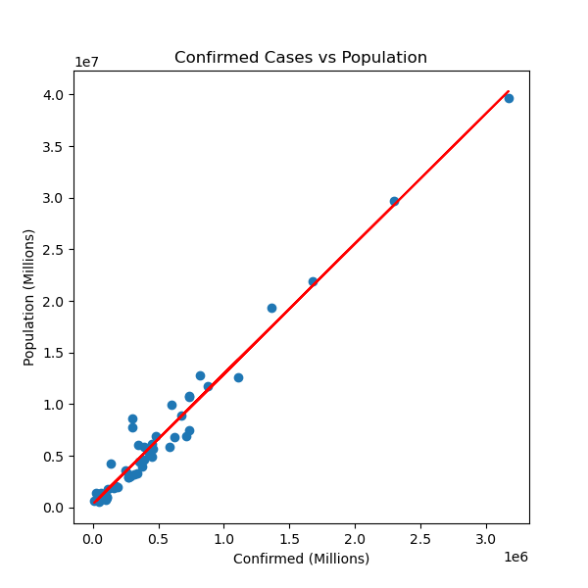
Following the Data-Is there a relationship between outbreaks and population or population density
Confirmed cases vs the population totals realized a near perfect correlation factor of .98
Density had almost no impact on the spread of the outbreak

Slide 6
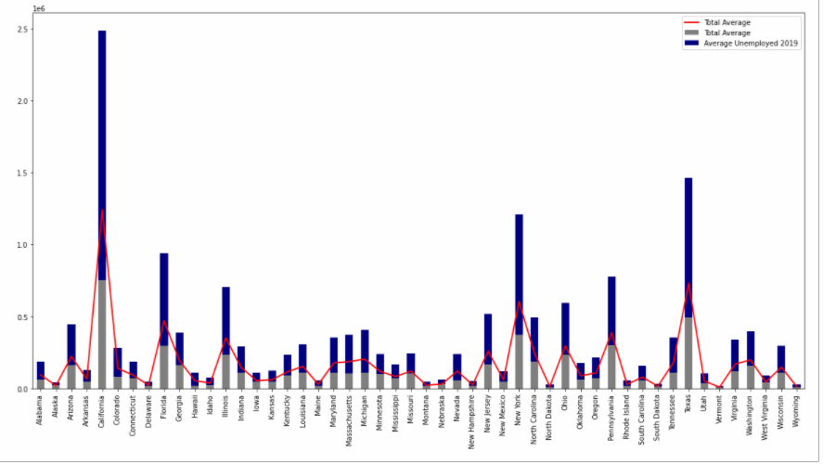
Number of People Unemployed in Each State
This chart indicates the increase in unemployment in 2020 vs 2019.
In most state the amount of people on unemployment more than doubled and is displayed by the red line.

Slide 7
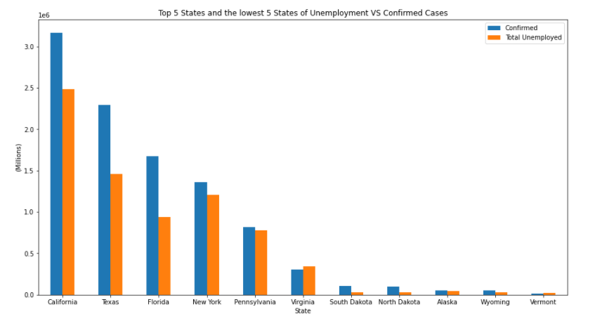
The blue indicates the Confirmed Cases in the top 5 states and the lowest 5 states. The orange indicates the total unemployed in those states.

Slide 8
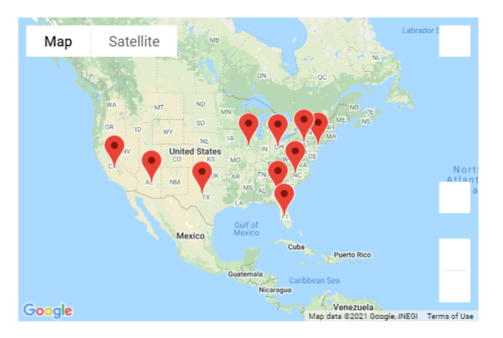
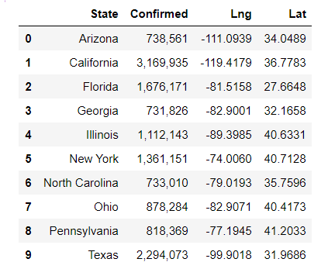
Top 10 Highest Locations of Confirmed Cases

Slide 9
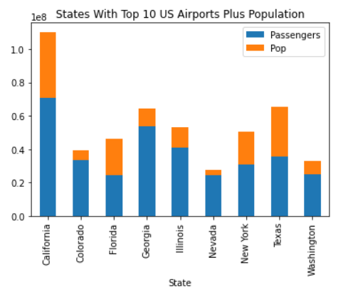
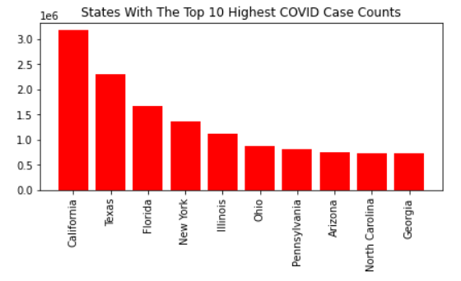
Looking for a connection between the top 10 US Airports, plus their Population,
to the States with the highest case counts

Slide 10
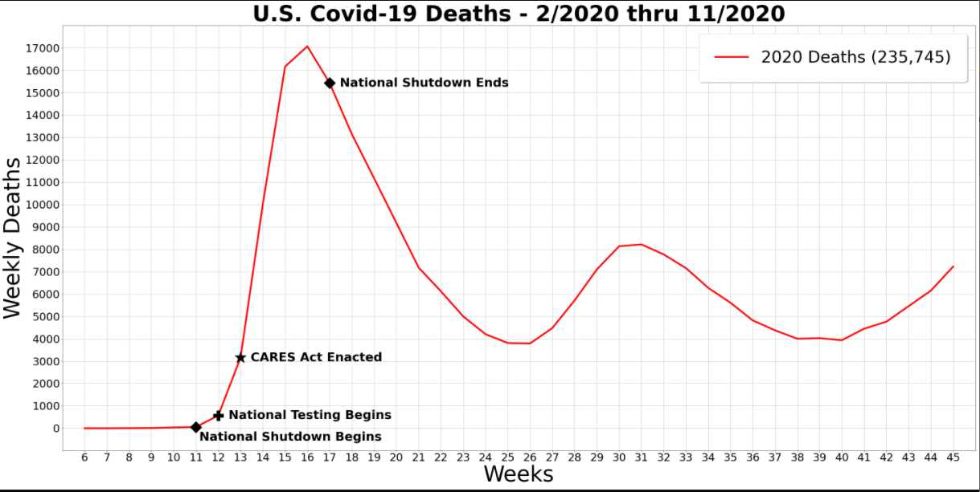

Slide 11
Outcome of mapping

